Slide 1
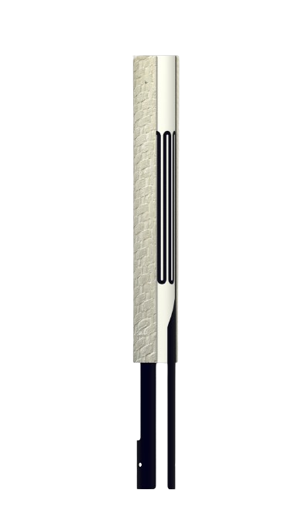


8-10 September 2025, Lisbon/Portugal
15th European Congress of Chemical Engineering (ECCE)
Electrically Heated Ceramic Composite Tubes for Dry Reforming of Methane
Daniel Kleschew, Prof. Ulrich Nieken

Slide 2
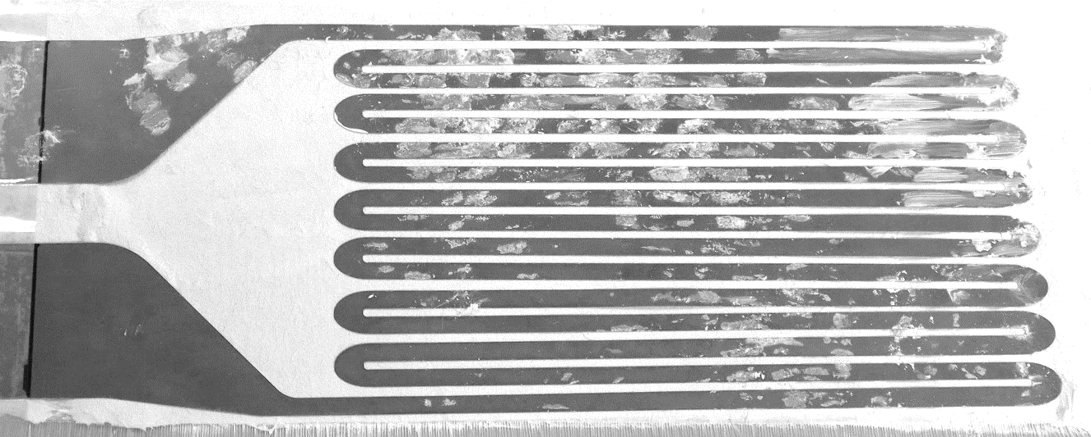
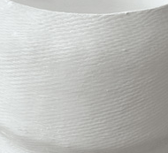

Electrification of Chemical Processes
Multilayer Ceramic Composite Tubes [1]
Joule Heating
Heating - Meander
Oxid Ceramic Matrix Composites
[1] Kolios, Grigorios, et al. (BASF SE) "Gas-tight, heat-permeable multilayer ceramic composite tube." U.S. Patent No. 10,865,151. 15 Dec. 2020

Slide 3


Experimental Setup
H₂ + CO
Reactor Concept
Tube-In-Tube Design
Local heat release by metallic heater
CH₄ + CO₂
Counter-Flow Concept:
$${\dot{Q}}_{el}$$
40 mm
Heat exchanger
$${\dot{Q}}_{H}$$
Heat recovery
Reactants
Reaction
70 mm
Products
Heat recovery through counter-flow system
Educts are preheated by products in the opposite direction
Heated reaction zone
OCMC Hybrid Tube
Monolithic Ceramic Outer tube

Slide 4
Heating Behavior
Process conditions
Electrically heated zone
Max.1150 °C
2.45 Ω
54 V
22 A
2.5 l/min
100 vol.% N₂
1200 W
Simulation:
Comsol with Bayesian Optimization
Temperatures up to 1150 °C achievable
Targeted heat input through heat conductor design

Slide 5
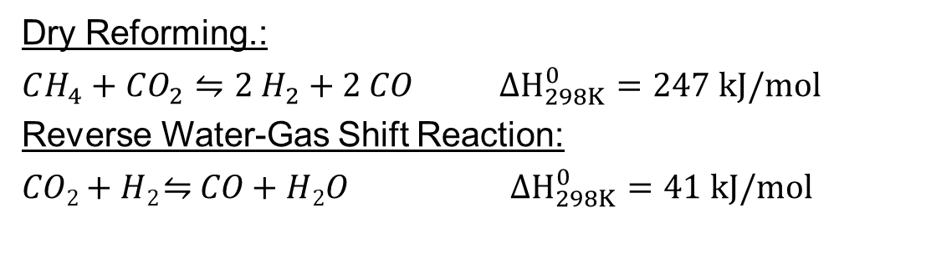
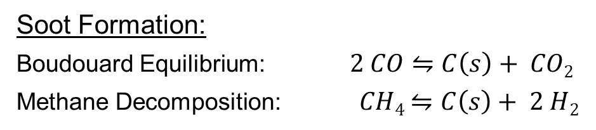
Why do we need high Temperatures?
Thermodynamic equilibrium @1 bar
Dry Reforming.:
$CH_{4}+CO_{2}⇋2 H_{2}+2 CO$ $ΔH_{298K}^{0}=247 kJ/mol$
Reverse Water-Gas Shift Reaction:
𝐶𝑂₂ + 𝐻₂ ⇋ 𝐶𝑂 + 𝐻₂𝑂 $ΔH_{298K}^{0}=41 kJ/mol$
Soot Formation:
Boudouard Equilibrium: $2 CO⇋C\left(s\right)+ CO2$
Methane Decomposition: $CH4⇋C\left(s\right)+ 2 H2$
High temperature improves conversion and minimizes soot formation

Slide 6
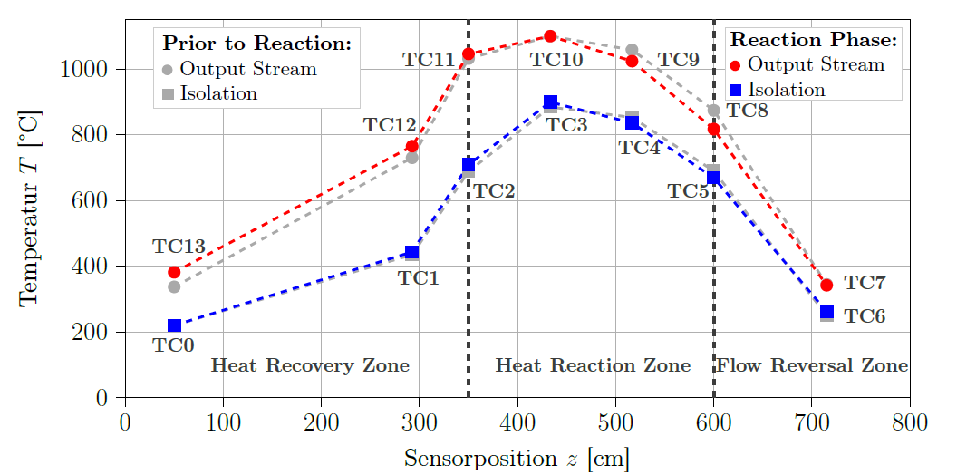
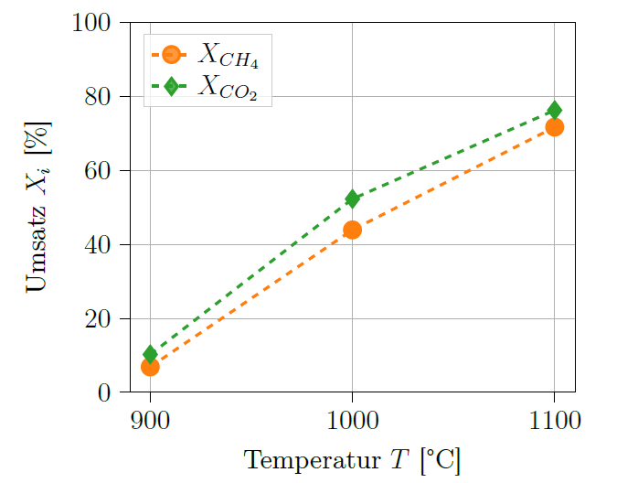




Proof of Concept: Dry Reforming with Electrically Heated OCMC-Tube
Controlled process conditions
Sufficient heating in an inert atmosphere
Guaranteed prevention of soot formation Electrically heated zone
2.5 l/min
20 vol.% CH₄
20 vol.% CO₂
Conversion $X_{i}$ [%]
No Catalyst
Max.1150 °C
Successful proof of concept demonstrated
Conversion increases with temperature
Maximum conversion 72% at 1100 °C
Temperature $T$ [°C]

Slide 7

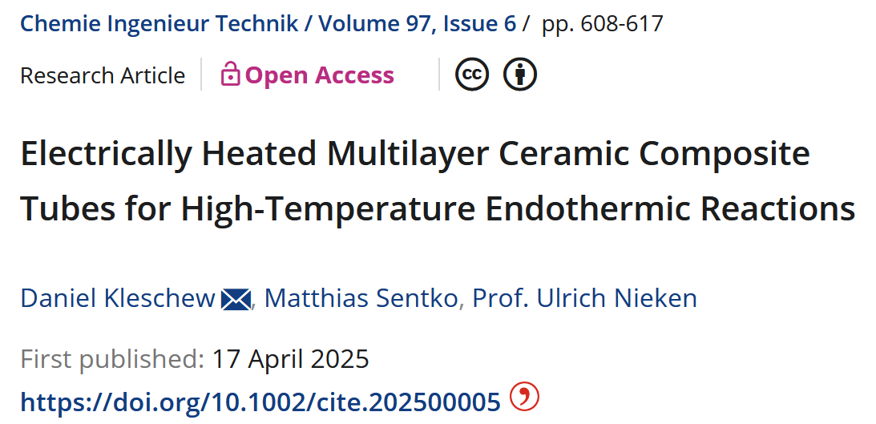
Thank you for your attention!
PAPER
Daniel Kleschew
daniel.kleschew@icvt.uni-stuttgart.de
85309
Special thanks to:
Institut für chemische Verfahrenstechnik
Böblinger Straße 78
70199 Stuttgart

